Slide 1
Hey kids: Do you like injecting code into OS kernels for profit? (Yeah!)
Greg Bekher
3-4 March 2016

Slide 2
Agenda
Day 1:
What’s a kernel? (hint: no popcorn)
Important OS elements (CMSC412 101)
How does a kernel rootkit tick?
How to code Linux kernel modules
Day 2:
Writing your first rootkit
Install rootkit on a VM, watch as it burns
Review code of a modern Linux rootkit
Detection methods
Wrap-up

Slide 3
Intro
What is a rootkit?
Why is a kernel rootkit especially bad?
Why should we care about rootkits?
Stuxnet story!

Slide 4
Intro
Why does Greg know all of this stuff about kernel rootkits?
Is he a government spy?
Secret agent?
More attractive James Bond?
James Bond supervillian?
Notes:
Science project

Slide 5

What’s a kernel?
When I said there is no popcorn I lied, there is actually popcorn
Notes:
But actually

Slide 6
But actually…

Slide 7
OS Kernel
The Kernel is the ‘core’ of the computer, that processes
Hardware input/output, interrupts
Translation of instructions from text to CPU
Memory management, user space process execution, etc.
As defined by Stallman, what we know as “Linux” is an operating system kernel, and added on user applications are elements of the GNU/Linux operating system itself

Slide 8
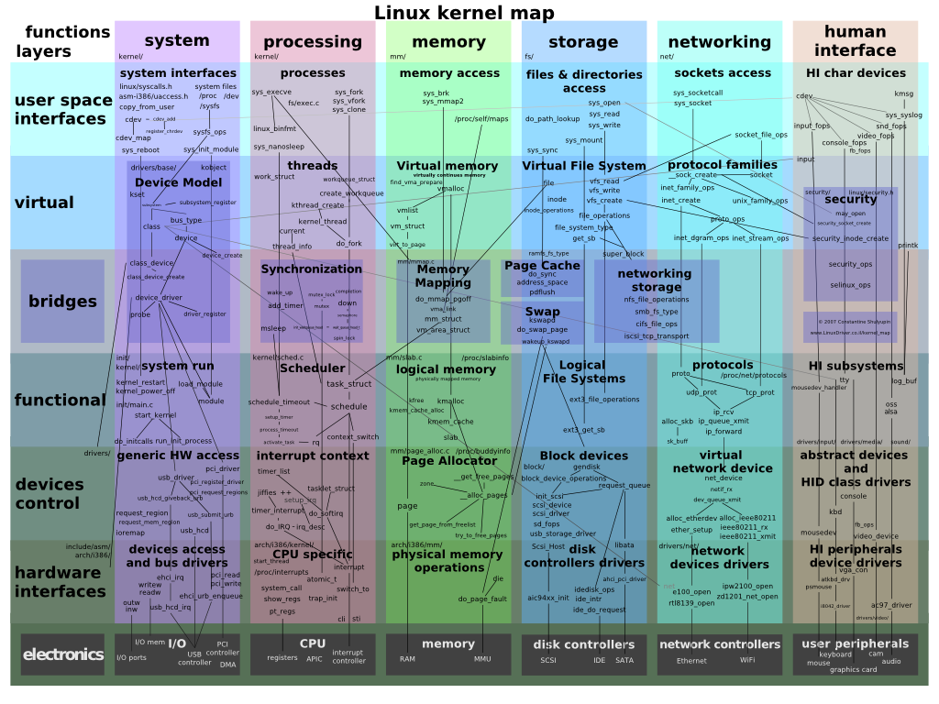
http://en.wikipedia.org/wiki/File:Linux_kernel_map.png
Notes:
This is how the different kernel components are interrelated.

Slide 9
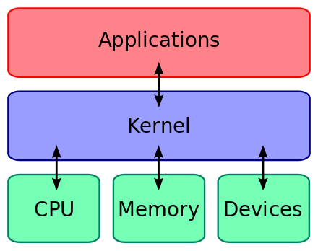
Basic kernel design
Notes:
Here’s a more simpler diagram. In essence, the kernel lets userspace apps execute the way they do. It’s the glue that holds things together

Slide 10
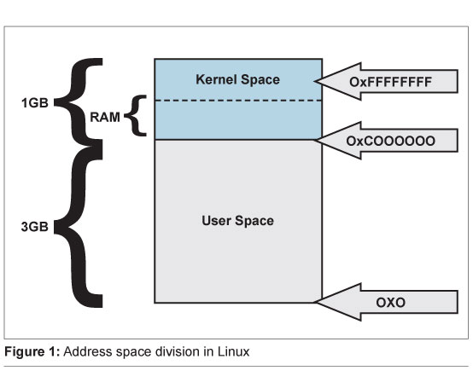
Kernel vs. Userspace Memory
Userspace processes can NOT write to kernel space memory
Semi-exception are kernel modules, which are inserted into the kernel and become a part of kernel memory
The kernel, however, can write to userspace
Notes:
A modern computer operating system usually segregates virtual memory into kernel space and user space.[a] Primarily, this separation serves to protect data and functionality from faults (by improving fault tolerance) and malicious behavior (by providing computer security).
[move this later] When we write user code, memory leaks, exceptions, segmentation faults, and general memory issues will typically result in the termination of the running application. However, kernel programmers have to be more careful because

Slide 11
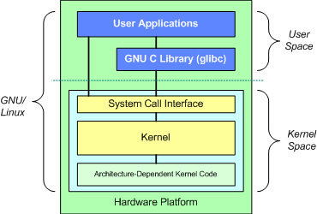
Userapp-Kernel communication
To talk to the kernel, run-of-the-mill userspace applications generally use glibc wrappers to execute system calls.
System calls operate by invoking the kernel, which will run the system call code, and deliver output to userspace.
Notes:
To complete many functional tasks, day-to-day applications need to execute system calls. What a system call does is it invokes the kernel, the kernel reads the input to the system call, it will execute the system call code, and return the output back to the user.

Slide 12
OS Elements
CMSC412 Incoming

Slide 13
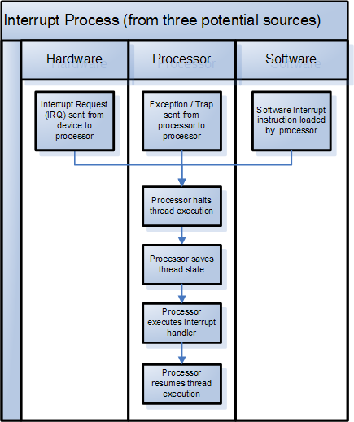
System interrupt
Signal to the processor
Handled by an interrupt handler in the kernel
Two types:
Hardware int
Software int
Notes:
The hardware or the software tells the processor, hey I need attention, look at me!

Slide 14
Hardware interrupt vs. Software interrupt
Hardware int:
Keyboard pressed, mouse moved
Disk says its done writing
Software int:
Software can interrupt, invoke the kernel when something needs to be done
Typically for hardware I/O, also used to interface directly with the kernel
Notes:
Hardware interrupts are used by devices to communicate that they require attention from the operating system.[2] Internally, hardware interrupts are implemented using electronic alerting signals that are sent to the processor from an external device, which is either a part of the computer itself, such as a disk controller, or an external peripheral. hardware interrupts are asynchronous and can occur in the middle of instruction execution, requiring additional care in programming. The act of initiating a hardware interrupt is referred to as an interrupt request (IRQ).
A software interrupt is caused either by an exceptional condition in the processor itself, or a special instruction in the instruction set which causes an interrupt when it is executed. The former is often called a trap or exception and is used for errors or events occurring during program execution that are exceptional enough that they cannot be handled within the program itself.

Slide 15
Interrupt Descriptor Table
IA32 (x86) implementation of an interrupt vector table
Map of kernel functions that handle the interrupt when the CPU is interrupted
Notes:
Don’t actually know what the image on the left is, btu it’s how an interrupt is handled. Callback function in the kernel, most likely super optimized assembly function

Slide 16
Other forms
x86-64 (and IA32e/IA64) have similar implementations
ARM equivalent: the interrupt vector table

Slide 17
System calls
Used to do things that userspace programs can’t do
A type of software interrupt: int 0x80
x86_64 introduces the syscall instruction
Notes:
The architecture of most modern processors, with the exception of some embedded systems, involves a security model. For example, the rings model specifies multiple privilege levels under which software may be executed: a program is usually limited to its own address space.
The startup_32() code found in /usr/src/linux/boot/head.S starts everything off by calling setup_idt(). This routine allocates the IDT. Later, start_kernel() is ran, then trap_init() which initializes the IDT, At this point the interrupt vector for the system calls is not set up. It is initialized by sched_init() (found in /usr/src/linux/kernel/sched.c). A call to set_system_gate (0x80, &system_call) sets interrupt 0x80 to be a vector to the system_call() entry point.

Slide 18
System calls
Five categories:
Process control (load, exec, kill/spawn)
File management (write, open, close, create)
Device management (write, read, release)
Info. Maintenance (get/set: time, process attrs, etc)
Communication (send, recieve messages, socket)

Slide 19
System calls
Write vs Sys_write (implementation)
write(…) is the system call as seen by the user
sys_write(…) is the system call as implemented by the kernel
Glibc function fork, exec are wrappers for system calls in the kernel
If you browse the kernel source, look in include/linux/syscalls.h, they are defined there.
They are actually implemented throughout the kernel, however (we will see in two sliedes)

Slide 20
int 0x80 usage (x86 asm)
_start:
movl $4, %eax ; use the write syscall
movl $1, %ebx ; write to stdout (fd=1)
movl $msg, %ecx ; use string "Hello World"
movl $12, %edx ; write 12 characters
int $0x80 ; make syscall
movl $1, %eax ; use the _exit syscall
movl $0, %ebx ; error code 0 (exit success)
int $0x80 ; make syscall

Slide 21
x86 vs x86_64
x86-64 (aka x64 or AMD64) is the 64-bit version of the x86 instruction set
Can run i386 code w/o emulation
Adds x64 instructions (movq -> quad word)
Use rxx registers for 64 bit ops (rax vs eax)
Most Linux distro’s that run on PC’s use the x86-64 instruction set
Different system call numbers, arch specific for x64: arch/x86/include/asm/unistd_64.h
Detailed info on x86 and x64 syscalls:
http://stackoverflow.com/questions/15168822/intel-x86-vs-x64-system-call

Slide 22
syscall usage (x86_64 asm)
_start:
movq $1, %rax ; different syscall num
movq $1, %rdi ; write to stdout (fd=1)
movq $msg, %rsi ; use string "Hello World"
movq $12, %rdx ; write 12 characters
syscall ; make syscall
movq $1, %rax ; use the _exit syscall
movq $0, %rdi ; error code 0 (exit success)
int $0x80 ; make syscall

Slide 23
System call table
Syscall numbers defined in
arch/x86/include/asm/unistd_64.h
Ex:
#define __NR_write 1
#define __NR_exit 60
Browse the Linux kernel source for a while like Greg does in his spare time and you’ll find… the signatures for syscall functions:
asmlinkage long sys_exit(int error_code);
asmlinkage long sys_creat(const char __user *pathname, umode_t mode);
asmlinkage long sys_chown(const char __user *filename, uid_t user, gid_t group);
Pulled directly from syscall.h
See: https://filippo.io/linux-syscall-table/
Notes:
The system call table is defined in unistd_64, tells the kernels what functions to call when a system call is sexecuted.

Slide 24
System call table
Notes:
This is what the system call table looks like. When the system call interrupt is executed in assembly, the value in the rax register is read, and depending on the value, a different syscall is ran.

Slide 25
Here’s the file
http://lxr.free-electrons.com/source/include/linux/syscalls.h

Slide 26
Thanks Greg
Why should I care about this interrupt call system table whatchamacallit junk?
I just wanted to go one day without looking at assembly code, why did you do this to me?
Thanks for asking!

Slide 27
What kernel rootkits modify
IDT/IVT
Syscall table
Syscall function content in memory
Random kernel functions
To hide ports, for example, rootkits often modify
tcp4_seq_show
tcp6_seq_show
udp4_seq_show
udp6_seq_show
Networking syscalls

Slide 28
How rootkits get into the kernel
Drivers
What’s as driver?
It’s a kernel module
Code that goes into the kernel
Kmods are loaded into kernel memory,

Slide 29
Code time
We’re going to write a quick kernel module
Sudo su
Install dependencies
apt-get install make
apt-get install gcc
apt-get install linux-headers-$(uname –r)

Slide 30
Hello world module
Modified from example on tldp.com
cd rt-techtalk/hello
Fill in the blanks in hello.c
You’ll want to define an entrance and exit function:
static int __init init_hello(void)
Note that this needs to return something, 0 for success
static void __exit cleanup_hello(void)
And you’ll want to set those functions to be the official entrance/exit
How to print stuff:
printk(KERN_INFO "Hello world!\n");

Slide 31
Hello world module
Modified from example on tldp.com:
/*
* hello.c
*/
#include <linux/module.h> /* Needed by all modules */
#include <linux/kernel.h> /* Needed for KERN_INFO */
#include <linux/init.h> /* Needed for the macros */
MODULE_LICENSE("GPL"); /* Prevent “tainting” the kernel */
MODULE_AUTHOR(”Your Name Here");
static int __init init_hello(void) {
/* printf? Ha! There’s no printf in the kernel */
printk(KERN_INFO "Hello world!\n");
return 0;
}
static void __exit cleanup_hello(void) {
printk(KERN_INFO "Goodbye world!\n");
}
module_init(init_hello);
module_exit(cleanup_hello);

Slide 32
Hello world module
Check out the makefile
obj-m += hello.o
all:
make -C /lib/modules/$(shell uname -r)/build M=$(PWD) modules
clean:
make -C /lib/modules/$(shell uname -r)/build M=$(PWD) clean

Slide 33
Hello world module
Compile:
Make (NEVER make as root)
Install module
sudo insmod hello.ko
View modules
sudo lsmod
Remove module
sudo rmmod hello
modprobe: do any of the above
dmesg | tail
View messages logged by your kmod

Slide 34
Hooking: The Concept
The sys_call_table is a pointer to the start of an array of pointers
Can access the pointer of a syscall with syscall_table[__NR_namegoeshere]
Is a function ptr
__NR_blah is the number of the syscall’s position in the SCT array, defined in unistd.h
Can we overwrite an entry in the syscall table with a pointer to our rouge function instead

Slide 35
Hooking: The Concept

Slide 36
Finding the syscall_table
To hook syscalls, we need to locate the start of the system call table in memory
Need to find sys_call_table, memory address to the start of the syscall table array
One way: compile the kernel, statically define sys_call_table by the value found in /boot/System.map-x.x.x

Slide 37
Finding the syscall_table
More complex way: find it dynamically.
unsigned long *find_sys_call_table ( void )
{
char **p;
unsigned long sct_off = 0;
unsigned char code[512];
rdmsrl(MSR_LSTAR, sct_off);
memcpy(code, (void *)sct_off, sizeof(code));
p = (char **)memmem(code, sizeof(code), "\xff\x14\xc5", 3);
if ( p )
{
unsigned long *sct = *(unsigned long **)((char *)p + 3);
sct = (unsigned long *)(((unsigned long)sct & 0xffffffff) | 0xffffffff00000000);
return sct;
}
else
return NULL;
}
Notes:
I took this code from the suterusu rootkit

Slide 38
Syscall hooking
For simplicity, we are statically defining our syscall table location.
Note that x86_64 has two sys_call tables, we will only be dealing with the first
However, the system call table is in protected memory…
Notes:
Now we have the table’s address: but if you have looked at the “grep” command you will have seen that there is an ‘R': this means that this address is “read-only”.
Indeed the kernel poses some structures in the “read-only” memory zone: in this way it protects them against intentional or unintentional changes which can lead to system instability. So we have to set this structure in “read/write” mode if we want to modify them.
Fortunately, the kernel provides us with special functions for this task:

Slide 39
Bypassing kernel write protections
Refer back to:
Note that there is an R (not a RW), meaning the page of memory where the sys_call_table array is write-protected.
Even at ring/privilege level 0
How can we bypass the kernel’s/processor’s write protect mode?

Slide 40
Disable write protection (with cr0)
Cr0 is a control register (32 bit on x86, 64 on x86-64)
CPU will prevent writing to protected memory pages if bit 16 is on (WP mode)
We need to flip this bit
Linux conveniently has a read_cr0 and write_cr0 function
To disable WP; bitwise and cr0 (not 0x10000):
write_cr0 (read_cr0 () & (~ 0x10000));
To enable WP; bitwise cr0 or 0x10000:
write_cr0 (read_cr0 () | 0x10000);

Slide 41
Disable write protection (a more clever way)
Also conveniently, the kernel has a function to change the rw/ro properties on kernel memory pages
Procedure:
Find the “set_pages_rw” and “set_pages_ro” symbols in the kernel map
Call those functions by dereferencing in the same way as cr0:
void (*pages_rw)(struct page *page, int numpages) = (void *)0xdeadbeef
struct page *sys_call_page_temp = virt_to_page(&syscall_table);
pages_rw(sys_call_page_temp, 1);
Safer than disabling cr0 system wide, even if it’s for <1ms
For today, we’ll just stick with cr0

Slide 42
Hooking sys_write
That’s all we need to know to write a basic kernel rootkit
Will not function as a rootkit by definition, but lays the foundation
We will only hook sys_write for simplicity’s sake, but to actually function as a ‘root’ kit, would need to hook:
asmlinkage int sys_setreuid (uid_t ruid, uid_t euid)

Slide 43
Hooking sys_write
Grep /boot/System.map-X.X.X for sys_call_table
Steps:
Define sys_call_table statically
Write a new sys_write()
Save old sys_write
Flip cr0
Copy new *sys_write into SCT
Flip cr0
Also cleanup
Function definition:
asmlinkage long sys_write(unsigned int fd, const char __user *buf, size_t count);

Slide 44
Myrootkit.c
Major keys:
You'll need the found syscall_table address found in the symbol map
In your hijacked write, you'll need to call the original write
syscall_table is an array of function pointers in memory…
__NR_write is a constant, which identified which location in syscall_table…
this makes it super easy to read to and write to the SCT for your hook…
For your init, disable protected memory mode is added for you, but you'll need to write the hook.
Remember to store the original write before you hook
You'll be restoring the original system call in exit()

Slide 45
Compile and run!
echo “fingers crossed” && make
insmod myrootkit.ko
Screen should be spamming “pwnd”
Type rmmod myrootkit to stop the madness (try not to make any typos)
Congrats! You’ve just written a rootkit

Slide 46
More fun
If you’re done early and are ambitions, try to hook sys_read:
Prototype for sys_read is
ssize_t read(int fd, void *buf, size_t count);
Very similar to sys_write
You would hook sys_read the same way as sys_write, but with the different func prototype
Include include/linux/string.h to do useful things
Try doing something along the lines of:
if (strcmp(buf, “secret string”) == 0) {
return count; //we don’t print their string
}
// else do something else
Aside: if you put the wrong address in for the SCT or clobber some weird memory memory address, you’ll likely get a kernel oops.
Try it, it’s fun!

Slide 47
Modern kernel rootkit
https://github.com/mncoppola/suterusu
Suterusu
Works on Linux 2.6, Linux 3.x, x86, x86_64, AMD64, and ARM (so yes, Android too)

Slide 48
Suterusu hooks two different ways
Replace the pointer to the system call in sys call table (what we did in the demo)
Or, write over the beginning the original system call, and modify instructions to jump to another function
Second way is more complex, requires rewriting the first few bytes of the original system call, and re-implementing the original call

Slide 49
Jmp from original SC
//Taken from suterusu
//x86:
// push $addr; ret
memcpy(n_code, "\x68\x00\x00\x00\x00\xc3", HIJACK_SIZE);
//x64:
// mov rax, $addr; jmp rax
memcpy(n_code, "\x48\xb8\x00\x00\x00\x00\x00\x00\x00\x00\xff\xe0", HIJACK_SIZE);
Because the above clobbers some of the original system call, for the above to work, you will need to write replacement code for the original system call
Cannot call back original system call since we are not copying the pointer.
Also, for cleanliness, you need to copy the bytes that you clobber, so that when you unhook, you can safely replace the old syscall.

Slide 50
The Good, the bad, the ugly
The good (or is this bad?):
we can monitor memory for changes that shouldn’t happen
almost all modifications can be caught
generally tough to install kernel rootkits
The bad & ugly:
can’t monitor in userspace
tough for regular users and admins to catch
monitoring may be intrusive, possibly unstable

Slide 51
Detection
Monitor IDT for changes
Monitor SCT for changes
Monitor the first n bytes of each syscall, rehash in an interval, monitor for changes
Issue is memory usage, would have to periodically check for changes
Above three methods require a clean baseline
Analyze memory addresses in SCT (strange offsets)
Monitor other hookable kernel functions
Watch for changes to cr0 register
Watch for RW changes to the SCT page

Slide 52
Presence
Project of mine from HS, monitors memory changes in critical kernel functions
Monitors for changes in SCT addrs, IDT, and misc kernel func*’s
By definition it is a kernel rootkit, which is super ironic
Future work: hash first n bytes of kernel func calls in memory, rehash periodically
github.com/bekher/presence

Slide 53
Questions?
This presentation + code is available here:
https://github.com/bekher/rt-techtalk

